Slide 1

INTELLIGENT BATTERY MANAGEMENT SYSTEM FOR
SOFTWARE-DEFINED EVS
ALT Project Review
Wednesday, SEPTEMBER 23rd, 2026
Team Members M.CHARAN SAI TEJ 2420090029 G.AKSHATH REDDY 2420030512 M.ADITHYA 2420090131 I.RAJESH 2420030684
 | Under the Guidance of Dr. SWANTHANA Assistant Professor, Department of Computer Science and Engineering, KLH CSE Bowrampet Campus

Slide 2
Outline of Research Work
Focus
Introduction
Literature Survey
Challenges
Research Objectives
Conclusion & Future Work
References
Publications Details

Slide 3
Problem Statement
Manual transcription: Police officers spend significant time converting spoken statements into written records.
Language barrier: Citizens may speak in Indian regional languages, dialects, or mixed languages.
Information loss: Important names, dates, locations, events and evidence details may be missed or misinterpreted.
Fragmented process: Speech recognition, translation and documentation are often handled separately.
Limited domain support: General AI tools are not tailored to police terminology and investigation documentation.
Security concern: Sensitive voice recordings and case documents require strong privacy, integrity and access control.
PRISM solution: Provides a self-hosted multilingual AI pipeline for voice → text → translation → structured police documentation with officer verification.

Slide 4
Objectives
Multilingual ASR: Convert Indian-language and mixed-language speech into text.
Real-Time Processing: Provide fast voice-to-text transcription.
Translation: Convert recognized speech into clear English.
NLP Extraction: Identify names, dates, locations, events and evidence.
Automated Documentation: Generate structured police records from statements.
AI Assistance: Generate relevant clarification questions when information is missing.
Secure Records: Protect data using encryption, hashing and permissioned blockchain auditing.

Slide 5
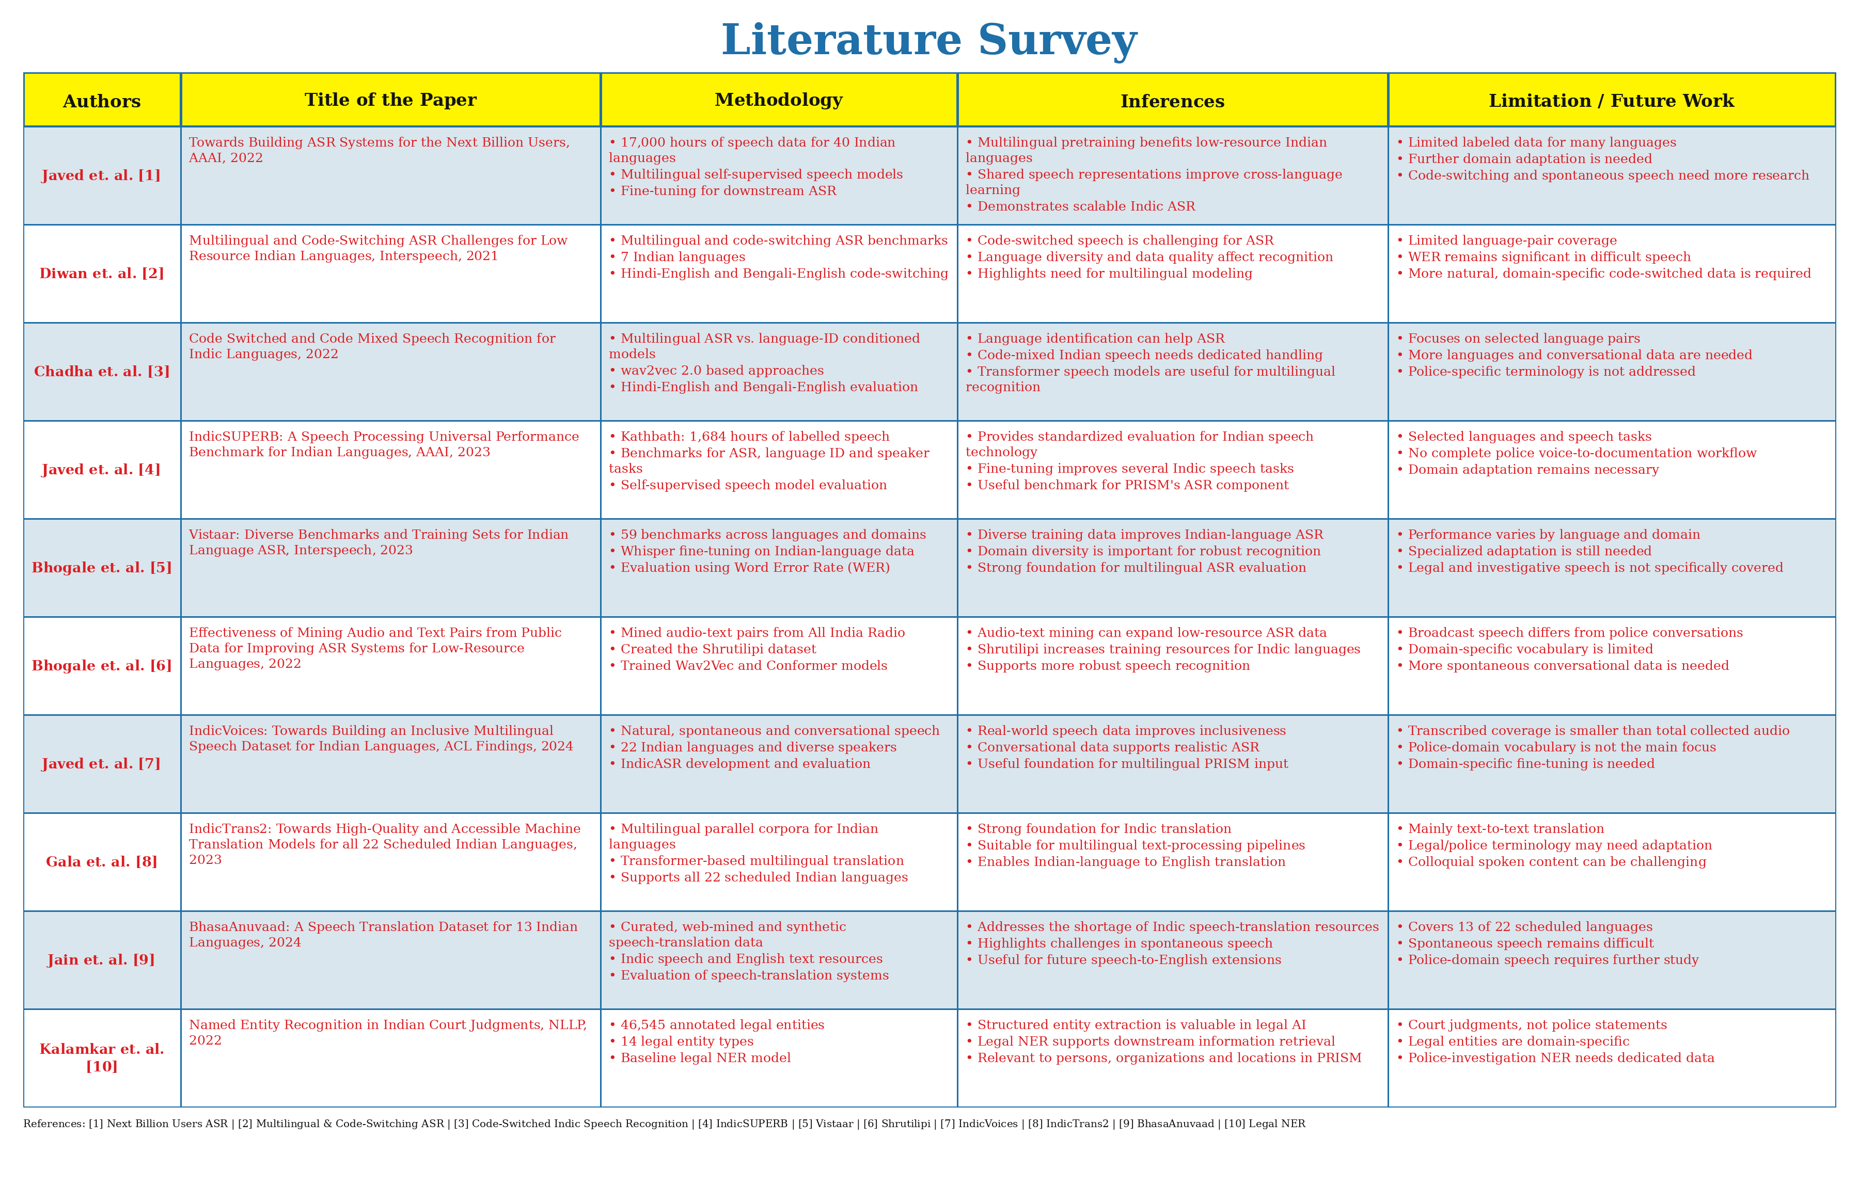

Slide 6
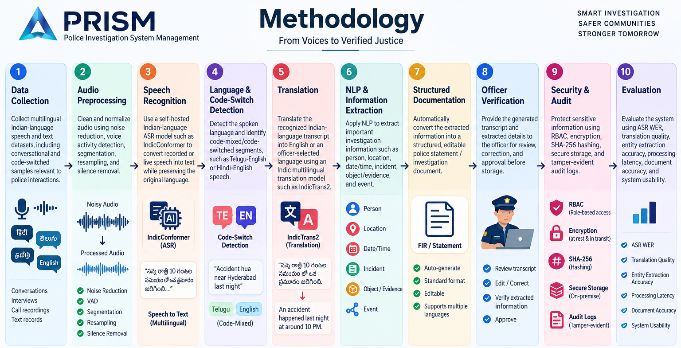

Slide 7
Research Gap Identification
Multilingual Gap: Limited integration of Indian-language and code-switched speech processing.
Domain Gap: General ASR/translation models are not optimized for police-specific terminology.
Integration Gap: Speech-to-text, translation, NLP and documentation are often separate processes.
Context Gap: Existing systems may not extract complete incident details from natural speech.
Automation Gap: Limited conversion of voice statements directly into structured police documents.
Security Gap: Need for stronger integrity and traceability for sensitive digital records.
PRISM Gap-Fill: Integrates ASR + NLP + translation + documentation + secure auditing into one workflow.

Slide 8
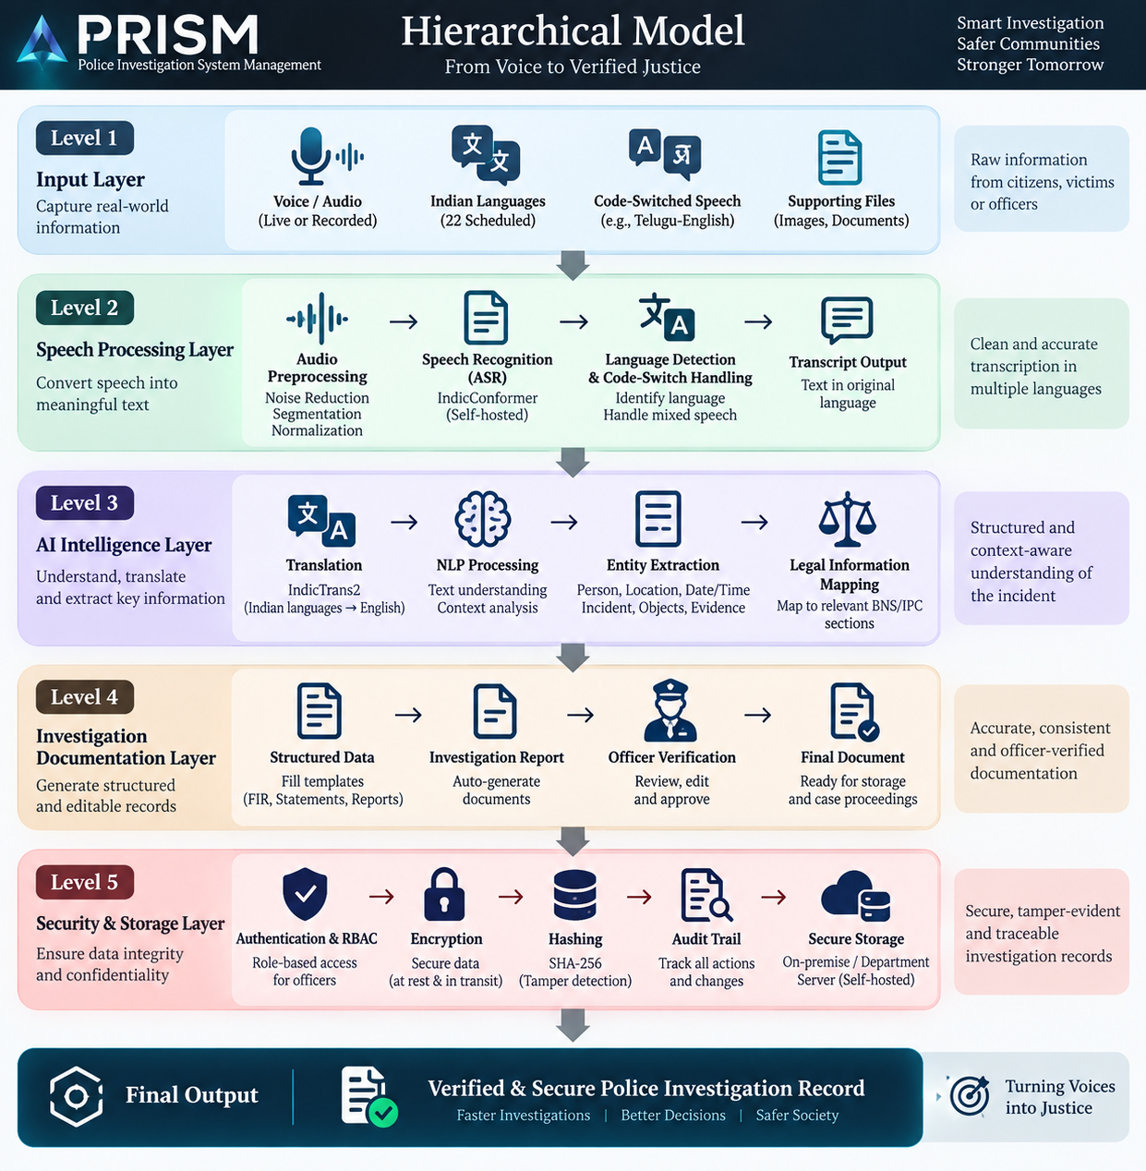

Slide 9
Innovation, Creativity, and Novelty
Multilingual AI: Supports Indian languages, dialects, and code-switched speech through AI-based speech recognition and translation.
Voice-to-Investigation: Converts natural spoken statements into structured, editable police documentation.
Context-Aware Intelligence: Uses NLP to extract key details such as people, locations, dates, events, and evidence from statements.
Integrated AI Workflow: Combines ASR, language detection, translation, NLP, and report generation in a single system.
Legal Intelligence: Helps map extracted incident information to relevant legal sections for officer verification.
Secure Evidence Integrity: Uses encryption, hashing, audit trails, and tamper-evident records to protect sensitive investigation data.
Self-Hosted & Privacy-Focused: Runs AI models locally, reducing dependence on external APIs and keeping police data within the department.

Slide 10
Feasibility and Project Plan
Feasibility
Technical Feasibility: Uses available open-source AI models such as Indic-Conformer, IndicTrans2, NLP models, Fast-API, React, and PostgreSQL.
Operational Feasibility: Designed for police officers with a simple voice-based workflow and minimal manual data
entry.
Security Feasibility: Supports self-hosted AI, encrypted storage, role-based access, hashing, and audit trails.
Scalability: Modular architecture allows additional Indian languages, AI models, and investigation modules to be added later.
Cost Feasibility: Open-source technologies reduce dependency on expensive commercial AI APIs and licensing.

Slide 11
Project Plan
Phase 1 – Research & Requirements: Problem analysis, literature survey, requirements and dataset identification.
Phase 2 – System Design: Architecture, database design, UI/UX and security design.
Phase 3 – AI Development: Speech recognition, language detection, translation and NLP pipeline.
Phase 4 – Application Development: React frontend, FastAPI backend and database integration.
Phase 5 – Integration & Security: Connect AI modules, authentication, encryption, hashing and audit logging.
Phase 6 – Testing & Evaluation: Accuracy, latency, usability, multilingual performance and security testing.
Phase 7 – Deployment: Local/self-hosted deployment, documentation and final demonstration.

